Slide 1
Ping and traceroute
Ping
  measure the time for a packet to travel to a remote host and back
  The server sends back an acknowledgment when the packet arrives
Traceroute
  list the router hops between the client host and a remote host.
  The IP address and domain name (if there is one) of each router is returned to the client

Slide 2
Ping clients
Windows comes with a Ping client
It has a command line interface, not a graphical user interface
It is run from a DOS command line window
For more on command line versus graphical user interfaces see:
http://bpastudio.csudh.edu/fac/lpress//471/hout/misc/guivcli.htm

Slide 3
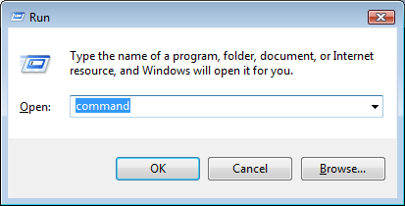
Open a command line window
Start > Run

Slide 4
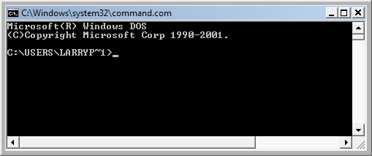
Command line prompt (>) with a blinking cursor
The prompt shows the current directory
DOS is ready for an operating system command or execution of a program – type the command or program name

Slide 5
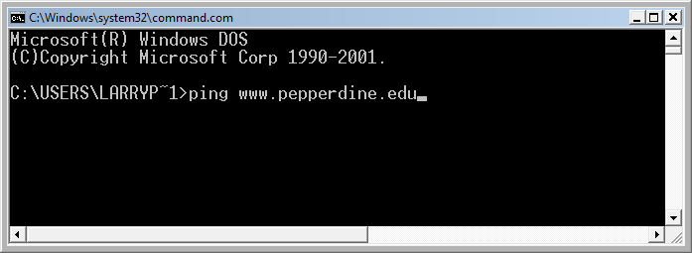
Ping command line
Program name
Remote host domain name

Slide 6
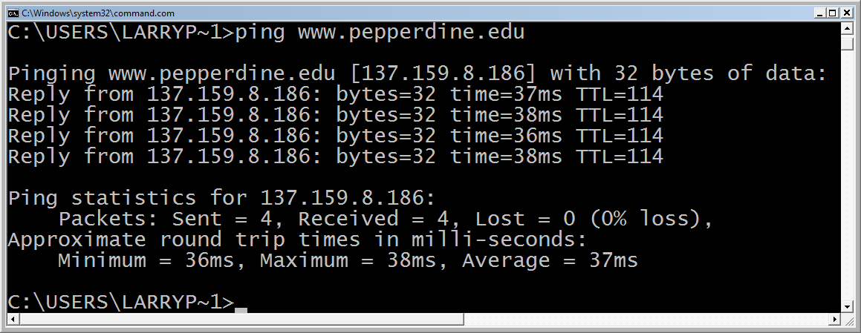
Ping results
1
2
3
4
The command to ping www.pepperdine.edu four times
The replies took between 36 and 38 milliseconds
No packets were lost
The average ping time was 37 milliseconds

Slide 7
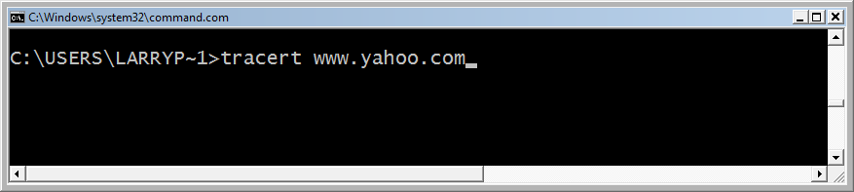
Traceroute command line
Program name
Remote host domain name
Note the abbreviated program name tracert – early DOS was limited to 8-character file names.

Slide 8
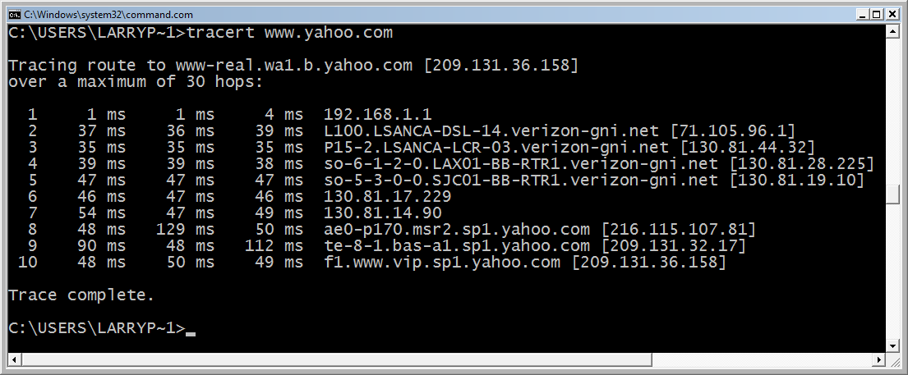
Traceroute results
Hop 1: my home LAN router
Hops 2-7: Verizon (my ISP) network
Hops 8-10: the Yahoo LAN

Slide 9
How do I know the IP address 130.81.17.229 and 130.81.14.98 belong to Verizon?

Slide 10
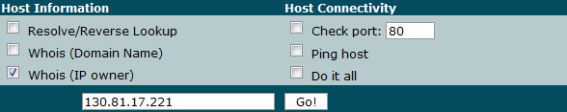
Query the Whois database for the owner of 130.81.x.x
http://www.dnstools.com
OrgName: Verizon Internet Services Inc.
OrgID: VRIS
Address: 1880 Campus Commons Dr
City: Reston
StateProv: VA
PostalCode: 20191
Country: US
NetRange: 130.81.0.0 - 130.81.255.255

Slide 11
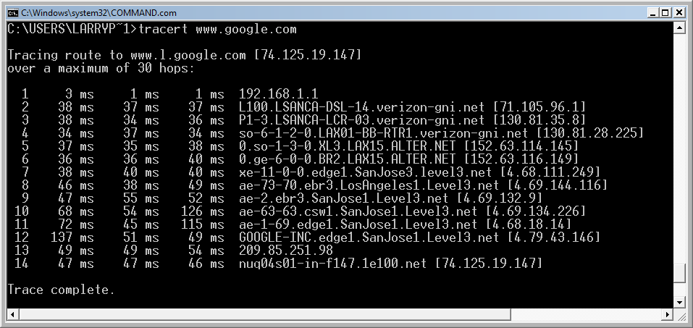
A longer route
Hop 1: my home LAN router
Hops 2-4: Verizon (my ISP) network (a backbone ISP)
Hops 5-6: Alternet (a backbone ISP)
Hops 7-11: Level 3 (a backbone ISP)
Hops 12-14: the Google LAN

